Slide 1



vLLM 架构剖析
ZOMI

Slide 2
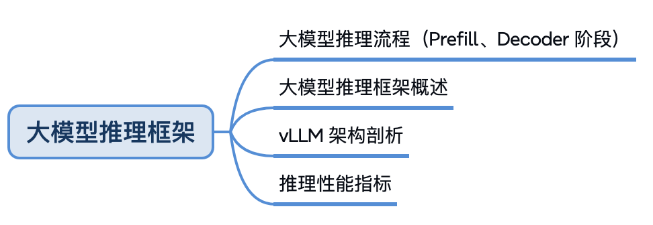
大模型推理

Slide 3




About us
Woosuk Kwon
PhD Student, UC Berkeley
@woosuk_k
Zhuohan Li
PhD Student, UC Berkeley
@zhuohan123

Slide 4

目录
vLLM Overview
vLLM 调用方式
vLLM 整体代码架构
vLLM 加载模型 & 预分配显存
vLLM Scheduler 调度
vLLM 整体架构总结

Slide 5
01
vLLM Overview

Slide 6
Our Goal
结合 iterative-level schedule (continuous batching) 和 PagedAttention 注意力算法以提高服务的吞吐量。
Build the fastest and easiest-to-use open-source LLM inference & serving engine

Slide 7
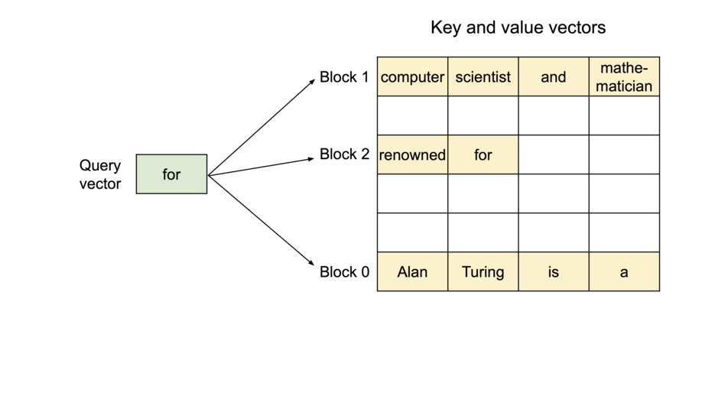
PagedAttention
An attention algorithm that allows for storing continuous keys and values in non-contiguous memory space.

Slide 8
Manage KV cache like OS virtual memory
Physical KV blocks
Block Table
computer | scientist | and | mathe- matician
Artificial | Intelli- gence | is | the
renowned
future | of | tech- nology
Alan | Turing | is | a
Block Table
Request
A
Request
B
Logical KV blocks
Logical KV blocks
Alan | Turing | is | a
computer | scientist | and | mathematician
renowned
Artificial | Intelli- gence | is | the
future | of | tech- nology

Slide 9



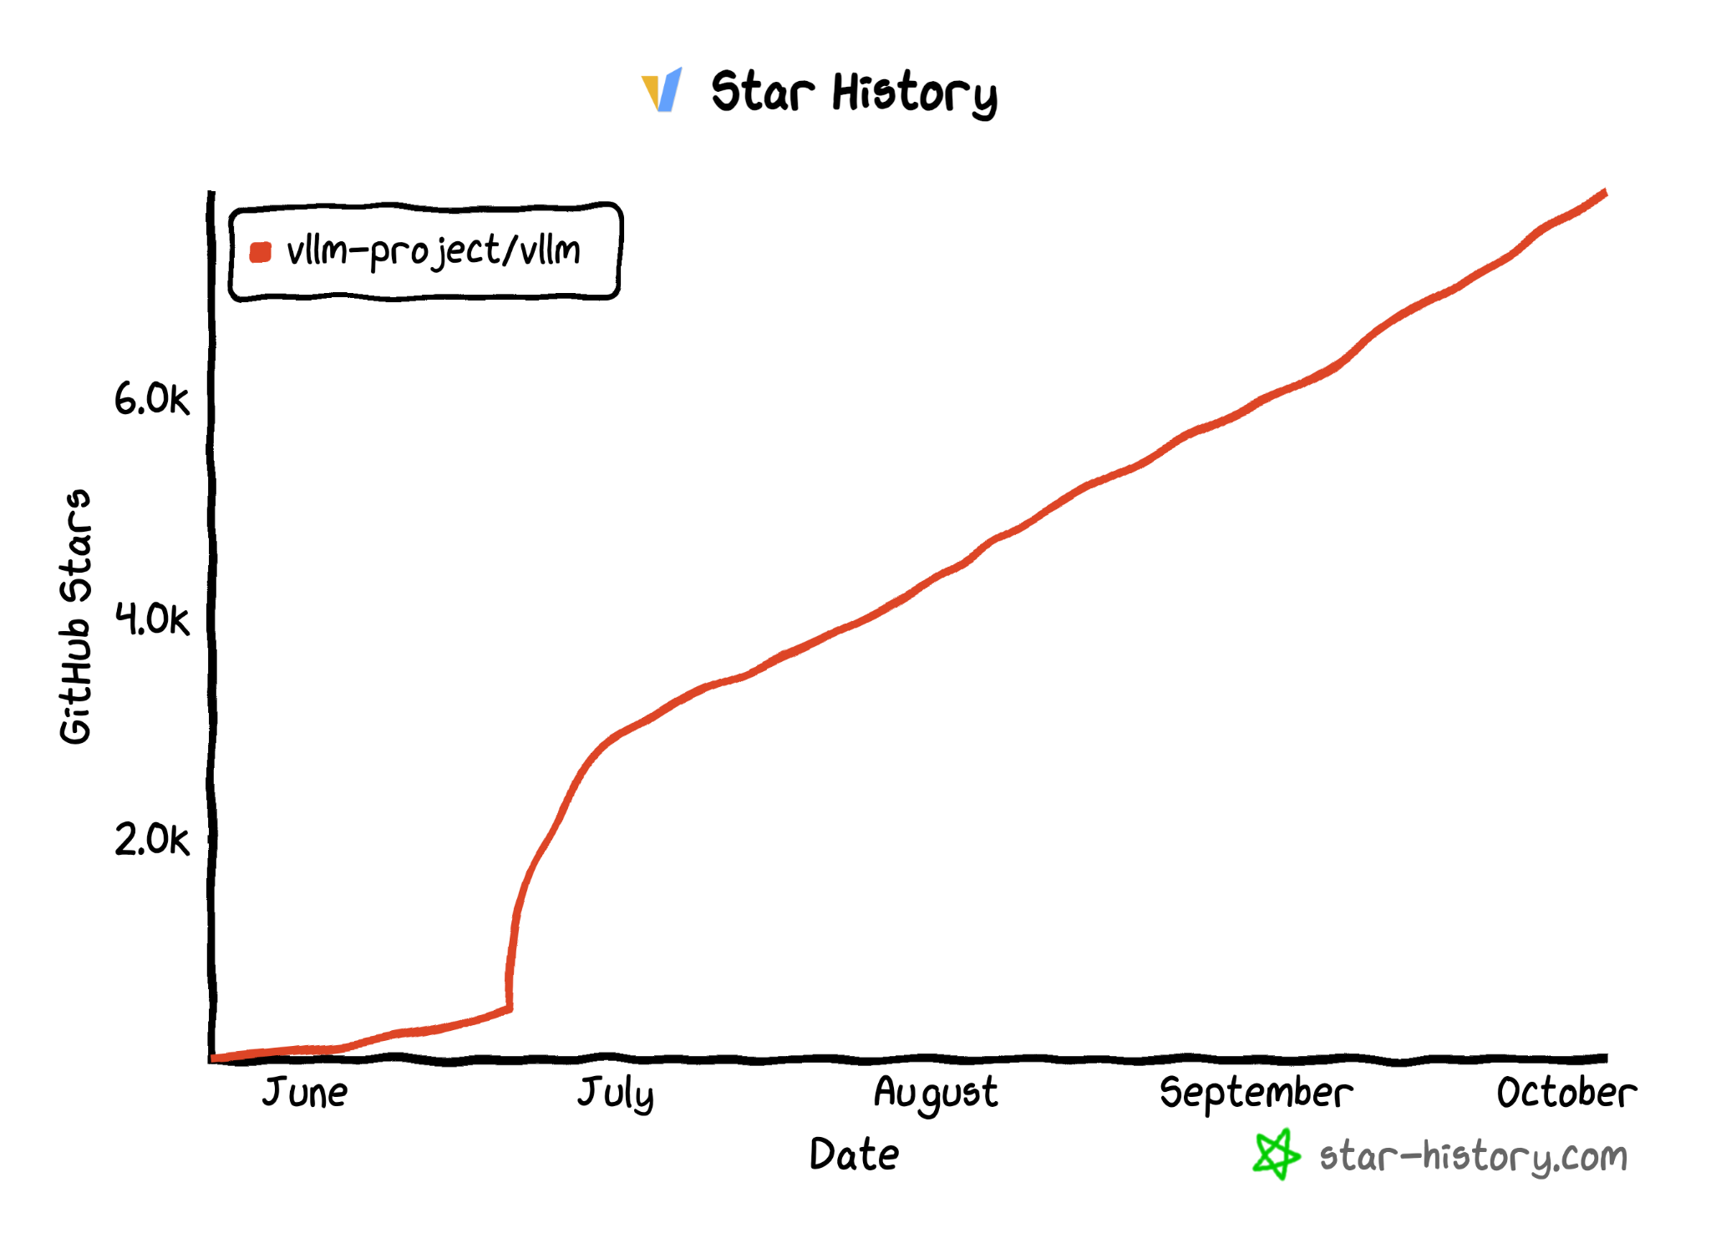
vLLM Github Repo
https://github.com/vllm-project/vllm
$ pip install vllm
33.9K Stars
Official
release!

Slide 10

















vLLM Adopters
Open-Source Projects
Companies
lm-sys/FastChat
allenai/open-instruct
…
WizardLM
…

Slide 11
“Talk is cheap. Show me the code.”
 | https://github.com/lm-sys/FastChat/blob/main/fastchat/serve/vllm_worker.py |  | https://github.com/GoogleCloudPlatform/vertex-ai-samples/tree/main/community-content/vertex_vision_model_garden/model_oss/vllm
 | https://github.com/imoneoi/openchat/blob/master/ochat/evaluation/run_eval.py |  | https://github.com/leptonai/examples/tree/main/advanced/vllm
 | https://github.com/allenai/open-instruct/blob/main/eval/toxigen/run_eval.py |  | https://github.com/facebookresearch/llama-recipes/tree/main/examples/vllm
 | https://github.com/skypilot-org/skypilot/blob/master/llm/vllm/serve.yaml |  | https://github.com/triton-inference-server/tutorials/tree/main/Quick_Deploy/vLLM
 | https://github.com/nlpxucan/WizardLM/blob/main/WizardCoder/src/humaneval_gen_vllm.py |  | https://github.com/modal-labs/modal-examples/blob/main/06_gpu_and_ml/vllm_inference.py
 | https://github.com/ray-project/ray/blob/master/doc/source/serve/doc_code/vllm_example.py |  | https://github.com/replicate/vllm-with-loras
 | https://github.com/bentoml/OpenLLM/blob/main/openllm-python/src/openllm/models/auto/modeling_vllm_auto.py |  | https://github.com/scaleapi/llm-engine/tree/main/model-engine/model_engine_server/inference/vllm
lm-sys/FastChat
allenai/open-instruct
WizardLM

Slide 12

Contributors
Thanks to all the contributors who raised issues, participated in discussions, and submitted PRs!
…

Slide 13
02
vLLM
调用方式

Slide 14
vLLM 推理调用方式
根据 vLLM 官方文档，向用户提供了两种调用它的方法，分别是：
Offline Batched Inference（同步，离线批处理）
API Server For Online Serving（异步，在线推理服务）

Slide 15
User Interface
End-user Interface vllm/entrypoints
Developer Interface vllm/engine
Synchronous
LLM
vllm/entrypoints/llm.py
LLMEngine
vllm/engine/llm_engine.py
Batched inference
def add_request()
def abort_request()
def step() → List[ReaquestOutput]
Stream one token output for a batch of requests
api_server
vllm/entrypoints/api_server.py
AsyncLLMEngine
vllm/engine/async_llm_engine.py
Simple demo API server
Asynchronous
openai_api_server
vllm/entrypoints/openai/api_server.py
async def generate()
async def abort()
+ background engine loop
OpenAI-compatible API server
User custom server

Slide 16
vLLM API (1): LLM class
A Python interface for offline batched inference
from vllm import LLM
# Example prompts.
prompts = ["Hello, my name is", "The capital of France is"]
# Create an LLM with HF model name.
llm = LLM(model="meta-llama/Llama-2-7b-hf")
# Generate texts from the prompts.
outputs = llm.generate(prompts)

Slide 17
离线批处理
在传统离线批处理中，我们每次给模型发送推理请求时，都要：
等一个batch的数据齐全后，一起发送
整个batch的数据一起做推理
等一个batch的数据全部推理完毕后，一起返回推理结果

Slide 18
vLLM API (2): OpenAI-compatible server
A FastAPI-based server for online serving
Server
$ python -m vllm.entrypoints.openai.api_server --model meta-llama/Llama-2-7b-hf
Client
$ curl http://localhost:8000/v1/completions \
-H "Content-Type: application/json" \
-d '{
"model": "meta-llama/Llama-2-7b-hf",
"prompt": "San Francisco is a",
"max_tokens": 7,
"temperature": 0
}'

Slide 19
LLMEngine 是 vLLM 的核心逻辑
End-user Interface vllm/entrypoints
Developer Interface vllm/engine
Synchronous
LLM
vllm/entrypoints/llm.py
LLMEngine
vllm/engine/llm_engine.py
Batched inference
def add_request()
def abort_request()
def step() → List[ReaquestOutput]
Stream one token output for a batch of requests
api_server
vllm/entrypoints/api_server.py
AsyncLLMEngine
vllm/engine/async_llm_engine.py
Simple demo API server
Asynchronous
openai_api_server
vllm/entrypoints/openai/api_server.py
async def generate()
async def abort()
+ background engine loop
OpenAI-compatible API server
User custom server

Slide 20
LLMEngine 是 vLLM 的核心逻辑
add_request()：
将每一个请求包装成 vLLM 能处理的数据类型（Sequence Group），并将其加入 Scheduler 的waiting 队列中。该函数按照“同步”方式设计，被设计为“遍历batch中每条数据，然后做相应处理”，只适合批处理场景。
abort_request()：
推理过程中，不是所有请求都能有返回结果。如客户端断开连接时，该请求推理就可以 abort。
step()：
负责执行 1 次推理过程。Scheduler 会决定要送那些数据去执行本次推理，并负责给这些数据分配好物理块（metadata）。模型会根据 metadata，采用 Paged Attention 完成实际计算。

Slide 21
vLLM 是一个巨大工程
它耦合了调度工程和模型本身的改造
代码中的嵌套非常复杂

Slide 22
03
vLLM
整体代码架构

Slide 23
requests (prompts)
LLMEngine
vllm/engine/llm_engine.py
Centralized Controller
(same process as LLMEngine, CPU only)
Distributed Workers (distributed processes with GPUs)
Scheduler
vllm/core/scheduler.py
N ×
Worker
vllm/worker/worker.py
BlockSpaceManager
vllm/core/block_manager.py
CacheEngine
vllm/worker/cache_engine.py
Worker.model
vllm/model_executor/models
BlockAllocator (GPU/CPU)
vllm/core/block_manager.py
PagedAttention
vllm/model_executor/layers/ attention.py
…

Slide 24
requests (prompts)
LLMEngine
vllm/engine/llm_engine.py
Centralized Controller
(same process as LLMEngine, CPU only)
Distributed Workers (distributed processes with GPUs)
Scheduler
vllm/core/scheduler.py
N ×
Worker
vllm/worker/worker.py
BlockSpaceManager
vllm/core/block_manager.py
CacheEngine
vllm/worker/cache_engine.py
Worker.model
vllm/model_executor/models
vLLM 核心组件是 LLMEngine 类，外层接口类 LLM 和 AsyncLLMEngine 都是对 LLMEngine 的封装。
LLMEngine 有两个核心组件，分别是负责请求调度的 Scheduler 和负责模型推理的 Worker， Scheduler 从等待队列中选择接下来要处理的请求Worker负责使用模型对被调度请求进行推理。
BlockAllocator (GPU/CPU)
vllm/core/block_manager.py
PagedAttention
vllm/model_executor/layers/ attention.py
…

Slide 25
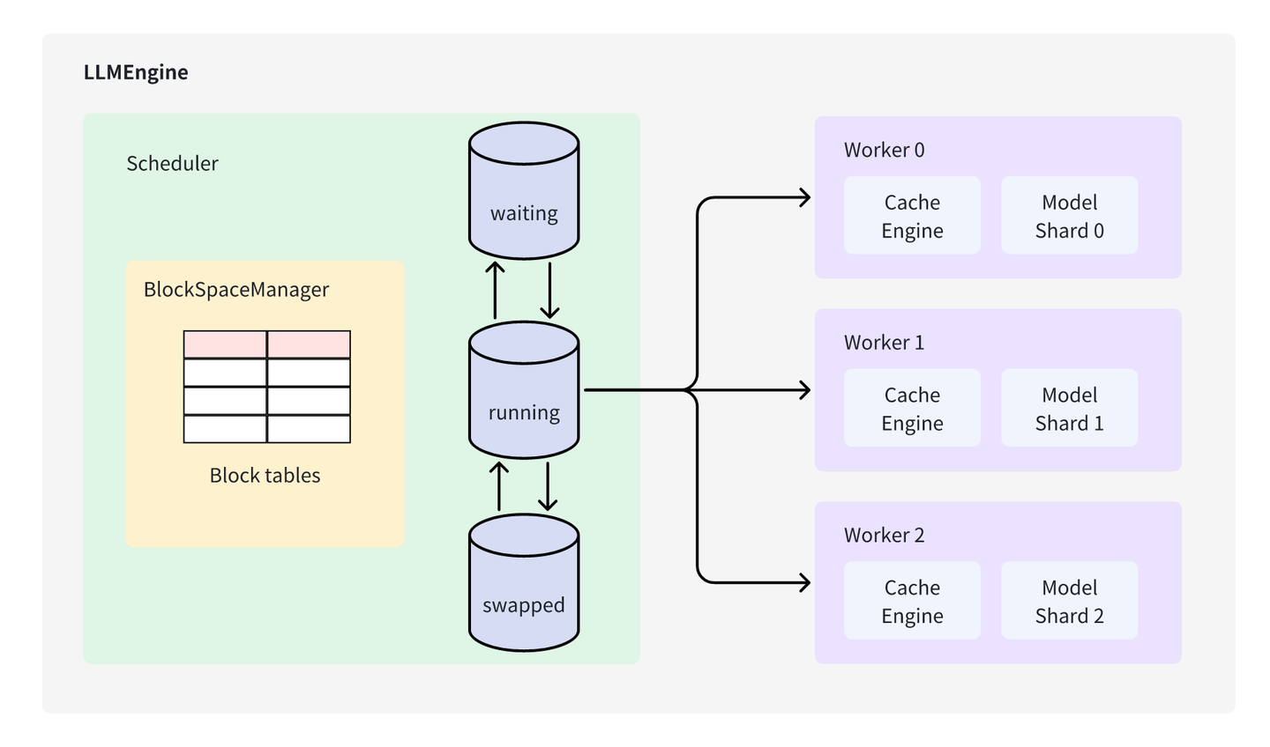
vLLM 整体代码架构

Slide 26
requests (prompts)
LLMEngine
vllm/engine/llm_engine.py
Centralized Controller
(same process as LLMEngine, CPU only)
Distributed Workers (distributed processes with GPUs)
Scheduler：
决定每个推理阶段的任务调度，主要负责选择哪些数据需要送到模型去推理，并且管理 KV Cache 的分配。然而，调度器并不直接处理这些物理缓存块的实际存储与管理，只是分配了缓存块的 ID，而数据的实际存储则由分布式 Worker 处理，这些 Worker 分布在 GPU 上。
Scheduler
vllm/core/scheduler.py
N ×
Worker
vllm/worker/worker.py
BlockSpaceManager
vllm/core/block_manager.py
CacheEngine
vllm/worker/cache_engine.py
Worker.model
vllm/model_executor/models
BlockAllocator (GPU/CPU)
vllm/core/block_manager.py
PagedAttention
vllm/model_executor/layers/ attention.py
…

Slide 27
requests (prompts)
LLMEngine
vllm/engine/llm_engine.py
BlockSpaceManager 和 BlockAllocator ：
管理计算所需的内存块。BlockSpaceManager 抽象管理器，BlockAllocator 则是真正参与内存分配的类，它有 CPU 和 GPU 两种类型，用于管理不同设备上的内存块。
BlockAllocator：
作用不仅限于 GPU 上的内存管理，还包括当 GPU 显存不足时，将某些缓存块卸载到 CPU 并进行管理，以便稍后再重新加载到 GPU 中。这种内存管理机制确保系统可以处理更大规模的模型而不受显存限制。
Centralized Controller
(same process as LLMEngine, CPU only)
Distributed Workers (distributed processes with GPUs)
Scheduler
vllm/core/scheduler.py
N ×
Worker
vllm/worker/worker.py
BlockSpaceManager
vllm/core/block_manager.py
CacheEngine
vllm/worker/cache_engine.py
Worker.model
vllm/model_executor/models
BlockAllocator (GPU/CPU)
vllm/core/block_manager.py
PagedAttention
vllm/model_executor/layers/ attention.py
…

Slide 28
requests (prompts)
LLMEngine
vllm/engine/llm_engine.py
Distributed Workers：
可以理解为多个 GPU 进程，每个 GPU 都有一个对应 Worker，负责模型实际加载和推理。
架构中称为 Worker，不仅执行推理，还对这些 Worker 实例进行整体管理和协调。
Centralized Controller
(same process as LLMEngine, CPU only)
Distributed Workers (distributed processes with GPUs)
Scheduler
vllm/core/scheduler.py
N ×
Worker
vllm/worker/worker.py
BlockSpaceManager
vllm/core/block_manager.py
CacheEngine
vllm/worker/cache_engine.py
Worker.model
vllm/model_executor/models
BlockAllocator (GPU/CPU)
vllm/core/block_manager.py
PagedAttention
vllm/model_executor/layers/ attention.py
…

Slide 29
requests (prompts)
LLMEngine
vllm/engine/llm_engine.py
Worker：
负责模型执行。如果模型过大，可以将模型切分到多个 Worker 共同完成请求处理。
假设模型有 4 层，现在有 4 张卡，可以设置 Tensor Parallel=4，则将模型切分为 4 份，每张卡存放模型的一部分。
Centralized Controller
(same process as LLMEngine, CPU only)
Distributed Workers (distributed processes with GPUs)
Scheduler
vllm/core/scheduler.py
N ×
Worker
vllm/worker/worker.py
BlockSpaceManager
vllm/core/block_manager.py
CacheEngine
vllm/worker/cache_engine.py
Worker.model
vllm/model_executor/models
BlockAllocator (GPU/CPU)
vllm/core/block_manager.py
PagedAttention
vllm/model_executor/layers/ attention.py
…

Slide 30
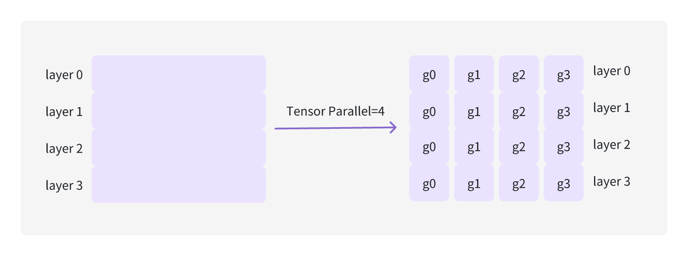
CacheEngine
Worker 一个核心组件是 CacheEngine，负责 KV cache 初始化以及 KV cache 相关操作。

Slide 31
requests (prompts)
LLMEngine
vllm/engine/llm_engine.py
每个 Worker 中都有两个关键模块：
CacheEngine：负责管理实际的缓存数据 KV cache ，确保所有计算任务都有合适资源可用。
Worker.model：负责模型加载和执行，利用 Paged Attention 组件来高效处理 Attention，从而保证推理任务性能。
Centralized Controller
(same process as LLMEngine, CPU only)
Distributed Workers (distributed processes with GPUs)
Scheduler
vllm/core/scheduler.py
N ×
Worker
vllm/worker/worker.py
BlockSpaceManager
vllm/core/block_manager.py
CacheEngine
vllm/worker/cache_engine.py
Worker.model
vllm/model_executor/models
BlockAllocator (GPU/CPU)
vllm/core/block_manager.py
PagedAttention
vllm/model_executor/layers/ attention.py
…

Slide 32
requests (prompts)
LLMEngine
vllm/engine/llm_engine.py
Centralized Controller
(same process as LLMEngine, CPU only)
Distributed Workers (distributed processes with GPUs)
Scheduler
vllm/core/scheduler.py
N ×
Worker
vllm/worker/worker.py
BlockSpaceManager
vllm/core/block_manager.py
CacheEngine
vllm/worker/cache_engine.py
Worker.model
vllm/model_executor/models
BlockAllocator (GPU/CPU)
vllm/core/block_manager.py
PagedAttention
vllm/model_executor/layers/ attention.py
…

Slide 33
04
Scheduler 和 Worker 的关系

Slide 34
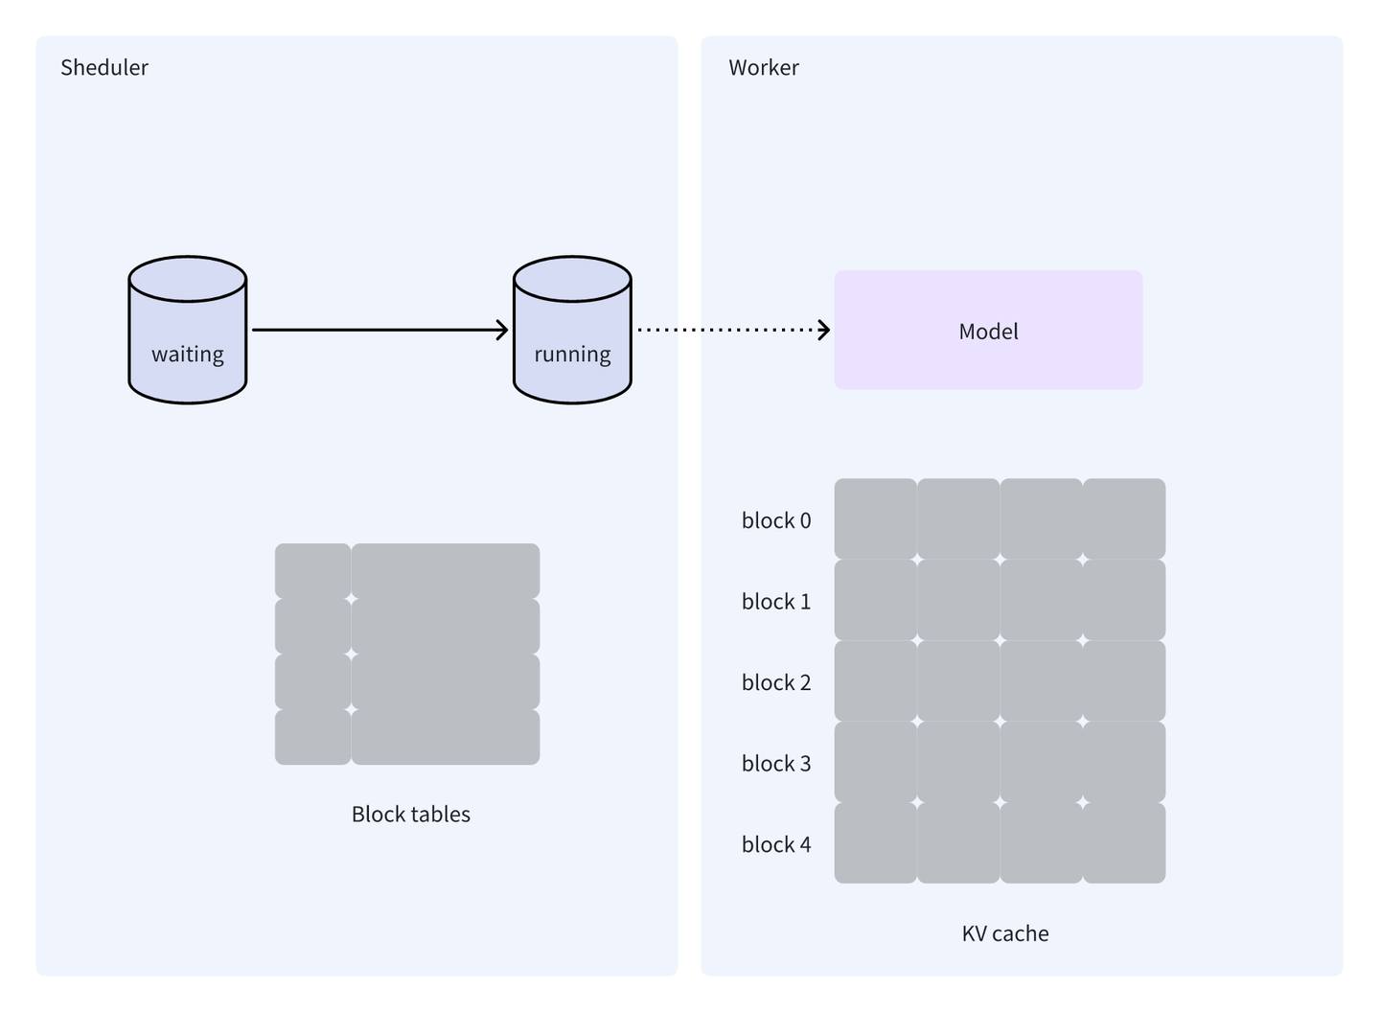
初始化阶段
主要初始化 LLMEngine 中 Scheduler 和 Worker 对象
Scheduler 初始化主要是块表（block table）
Worker 初始化包括模型的初始化以及 KV cache 的初始化

Slide 35
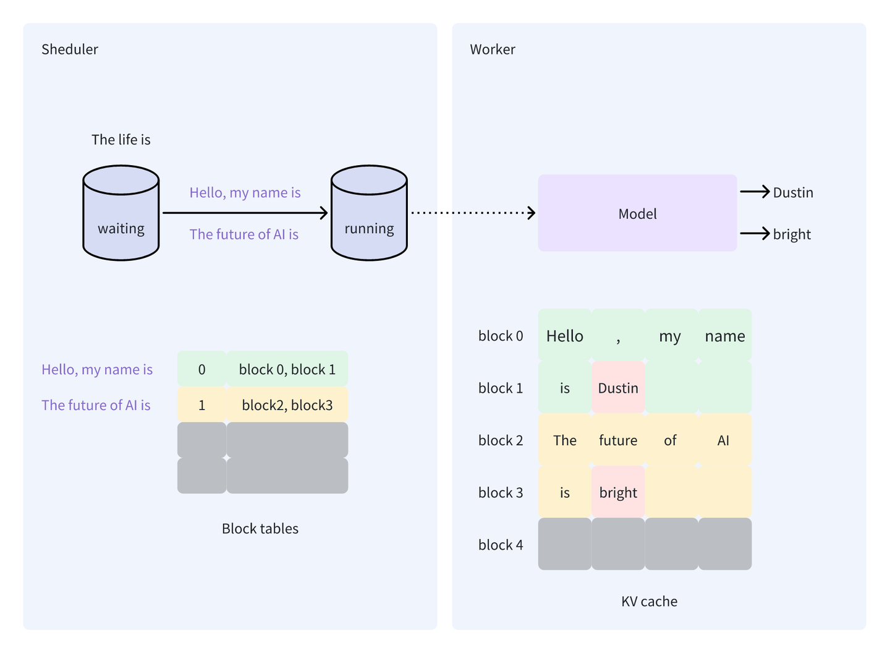
调度和推理
设 vLLM 接收到 3 个请求（s0, s1, s2）并放入 waiting 队列中
它们 prompt 分别为 “Hello, my name is”、“The future of AI is” 和 “The life is”。接下来开始 vLLM 调度和处理

Slide 36
LLM 的第一轮处理
设 vLLM 在这一轮只能调度两个请求进行处理，根据 FIFO 原则
从 waiting 队列中选择 s0 ("Hello, my name is") 和 s1 ("The future of AI is") 放入到 running 队列
s0 Worker 生成 token 为 Dustin；s1 Worker 生成 token 为 bright
同时，Worker 会将计算过程产生的 KV 值存储在 KV cache 中

Slide 37
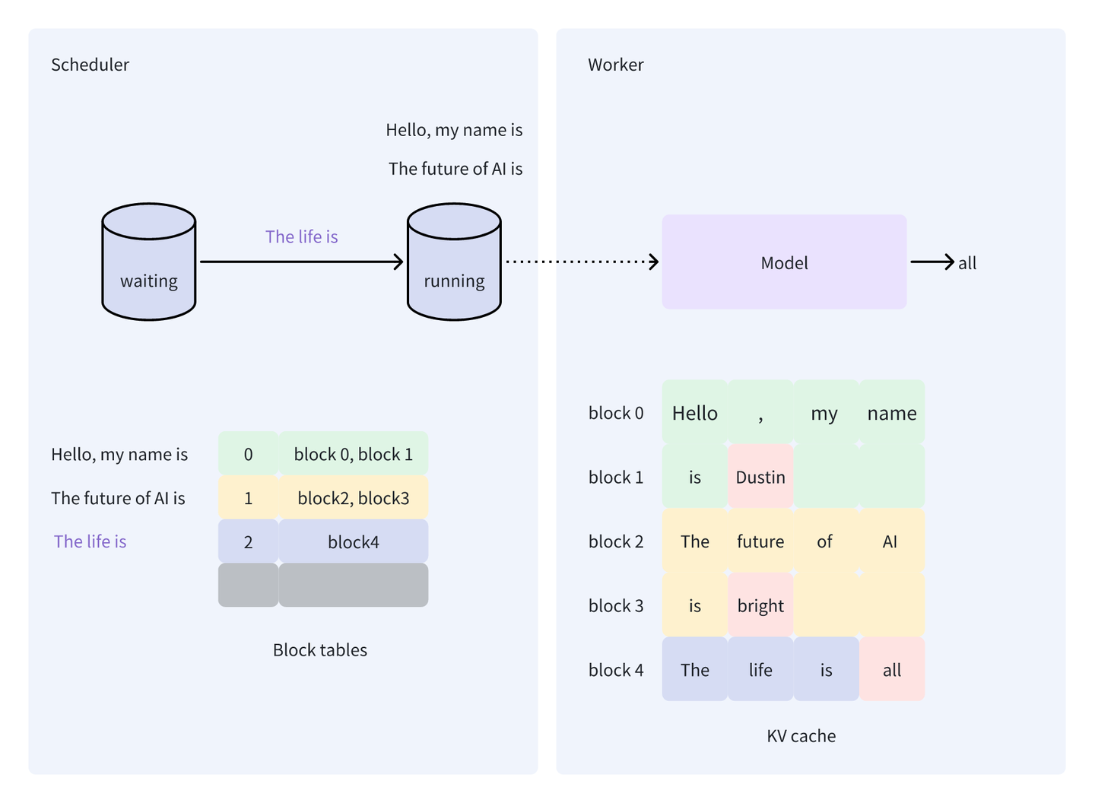
vLLM 的第二轮处理
由于 waiting 队列中还有一个请求 s2（The life is)
因此，vLLM 在第二轮只会处理这一个请求，前面提到，vLLM 只会处理要么都是填充阶段的请求，要么都是生成阶段的请求。

Slide 38
vLLM 的第三轮处理
waiting 队列中没有要处理新请求，从 running 队列中选择此轮要处理的请求
但由于没有多余空间，vLLM 只会选择 s0 和 s1 进行处理
经过多轮调度和推理，最终完成 3 个请求的处理

Slide 39
05
vLLM 加载模型&预分配显存

Slide 40


Before serving requests 1. Initialize & load model
LLMEngine
vllm/engine/llm_engine.py
初始化并加载模型权重
具体执行前，vLLM 需要初始化并加载模型权重。
vLLM 支持从 HF Hub 加载模型，也支持本地加载模型。
在加载模型的过程中，vLLM 会将模型权重加载到 GPU 中，以便后续推理任务可以直接在 GPU 上执行。
Worker
vllm/worker/worker.py
× N
Worker.model
vllm/model_executor/models
model.load_weights
vllm/model_executor/models
Initialize & load from HuggingFace Model Hub

Slide 41

Before serving requests 2. Profile memory usage
LLMEngine
vllm/engine/llm_engine.py
Worker
vllm/worker/worker.py
× N
Worker.profile_num_available_blocks
vllm/model_executor/models
Worker.model
vllm/model_executor/models
Profile the memory usage with a batch with the max possible #tokens.
#GPU KV blocks = remaining memory / block byte size

Slide 42
Before serving requests 2. Profile memory usage
通过模拟实验来决定 GPU 和 CPU 上可以分配 KV cache 物理块数量，确保后续推理时内存分配不会显存溢出（determine_num_available_blocks）
启动时系统会进行“假数据模拟”来测量模型内存使用情况。构造假数据并执行一次模拟前向推理，观察 GPU 上模型运行时峰值内存需求。
前向推理中，系统不使用 KV cache，而是单纯地模拟模型推理所需基本内存。帮助确定推理过程会占用多少显存，为后续内存分配提供依据。
LLMEngine
vllm/engine/llm_engine.py
Worker
vllm/worker/worker.py
× N
Worker.profile_num_available_blocks
vllm/model_executor/models
Worker.model
vllm/model_executor/models
Profile the memory usage with a batch with the max possible #tokens.
#GPU KV blocks = remaining memory / block byte size

Slide 43
Before serving requests 2. Profile memory usage
完成内存需求测量后，vLLM 使用测得内存数据来计算可分配给 KV cache 显存总量。可以确保显存分配合理，不会因为内存不足而导致 OOM 错误。
物理块大小由用户定义，包括多个参数，如 block_size、num_heads、head_size、num_layers 以及数据类型的大小。
计算公式会依据这些参数来估算单个物理块的大小，然后根据剩余显存估算出可以分配的物理块总数。
LLMEngine
vllm/engine/llm_engine.py
Worker
vllm/worker/worker.py
× N
Worker.profile_num_available_blocks
vllm/model_executor/models
Worker.model
vllm/model_executor/models
Profile the memory usage with a batch with the max possible #tokens.
#GPU KV blocks = remaining memory / block byte size

Slide 44


Before serving requests 3. Pre-allocate KV Blocks
LLMEngine
vllm/engine/llm_engine.py
Scheduler
vllm/core/scheduler.py
Worker
vllm/worker/worker.py
× N
#GPU KV blocks
BlockSpaceManager
vllm/core/block_manager.py
CacheEngine
vllm/worker/cache_engine.py
#GPU KV blocks
BlockAllocator (GPU/CPU)
vllm/core/block_manager.py
Allocate KV cache memory
Initialize block table

Slide 45
Before serving requests 3. Pre-allocate KV Blocks
LLMEngine
vllm/engine/llm_engine.py
Scheduler
vllm/core/scheduler.py
Worker
vllm/worker/worker.py
× N
#GPU KV blocks
BlockSpaceManager
vllm/core/block_manager.py
CacheEngine
vllm/worker/cache_engine.py
预分配 KV Cache
改过程核心是创建 empty tensor，并将它们直接分配到 GPU 上，从而锁定显存用于 KV cache。这种显存预分配方式能够避免推理过程中频繁动态内存分配，提升系统稳定性和推理效率。
显存占用比单纯加载模型时要多。因为额外显存已经被预先分配给 KV cache，确保在推理时不会受到其他任务影响。
#GPU KV blocks
BlockAllocator (GPU/CPU)
vllm/core/block_manager.py
Allocate KV cache memory
Initialize block table

Slide 46
06
vLLM
整体架构总结

Slide 47


请求完成与结果返回
streaming results
requests (prompts)
LLMEngine
vllm/engine/llm_engine.py
detokenize
1 new token ID for each request
Centralized Controller
(same process as LLMEngine, CPU only)
Distributed Workers (distributed processes with GPUs)
Scheduler
vllm/core/scheduler.py
unfinished requests
Worker
vllm/worker/worker.py
N ×
BlockSpaceManager
vllm/core/block_manager.py
CacheEngine
vllm/worker/cache_engine.py
Worker.model
vllm/model_executor/models
BlockAllocator (GPU/CPU)
vllm/core/block_manager.py
PagedAttention
vllm/model_executor/layers/ attention.py
…

Slide 48
请求完成与结果返回
streaming results
requests (prompts)
LLMEngine
vllm/engine/llm_engine.py
detokenize
1 new token ID for each request
Centralized Controller
(same process as LLMEngine, CPU only)
Distributed Workers (distributed processes with GPUs)
Scheduler
vllm/core/scheduler.py
unfinished requests
Worker
vllm/worker/worker.py
N ×
推理完成后，结果会被发送回 LLMEngine。LLMEngine 会对生成 tokens 进行 detokenization，将它们转换回可读文本，并最终将生成结果流式地返回给用户。这一流程使得生成的结果可以尽快交付给用户，而无需等待整个请求的完全完成。
整个请求的处理流程由 LLMEngine 进行协调调度，通过 Scheduler 管理内存和资源的有效利用，Worker 在 GPU 上执行具体的推理计算，最终将结果流式地返回给用户。
BlockSpaceManager
vllm/core/block_manager.py
CacheEngine
vllm/worker/cache_engine.py
Worker.model
vllm/model_executor/models
BlockAllocator (GPU/CPU)
vllm/core/block_manager.py
PagedAttention
vllm/model_executor/layers/ attention.py
…

Slide 49
Summary
Core component: LLMEngine
Centralized controller → Distributed workers
Scheduler prepares the requests at each step
Workers run the model with PagedAttention

Slide 51
https://zhuanlan.zhihu.com/p/691045737
https://github.com/PaddleJitLab/CUDATutorial/blob/develop/docs/16_vllm_source_code/01_vllm_arch.md
https://arxiv.org/pdf/2309.06180
https://docs.google.com/presentation/d/1RgUD8aCfcHocghoP3zmXzck9vX3RCI9yfUAB2Bbcl4Y/edit#slide=id.g2716b686c46_0_3

